Slide 1
Erdas 基本操作

Slide 2

一、Viewer基本功能

Slide 3
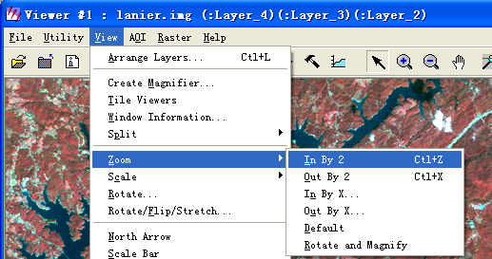
Zoom
In--放大 Out--缩小
1、
2、zoom in by two
zoom out by two

Slide 4
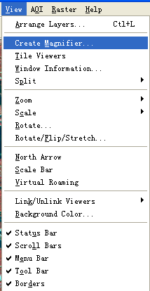
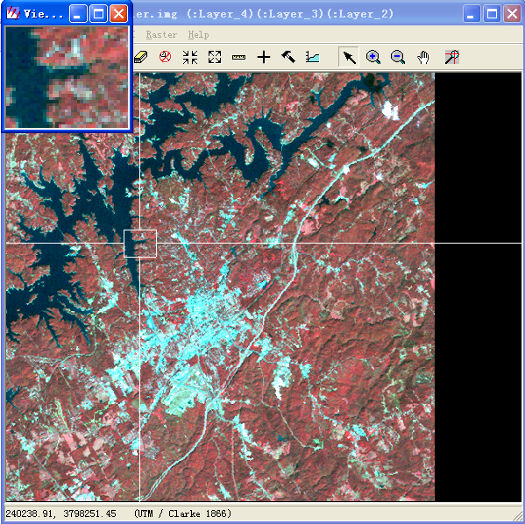
Create Magnifier

Slide 5
Real-time zoom
1、选择放大或缩小
2、按住键盘上的Ctrl键，同时在图像上按左键拖曳。

Slide 6
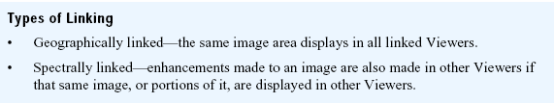
Link
示例图像：EOSAT TM.img Landcover.img
1、在两个窗口分别打开两幅图像
2、在其中一个窗口中选择view--link/unlink viewers—Geographical
3、按照提示在另一个窗口的图像上单击鼠标左键
4、在一个窗口中漫游，放大、缩小、拖曳，可以看到link的效果

Slide 7
Unlink
1、在其中一个窗口中选择view--link/unlink viewers—Geographical
2、按照提示在另一个窗口的图像上单击鼠标左键

Slide 8
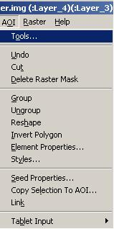
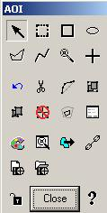
AOI

Slide 9
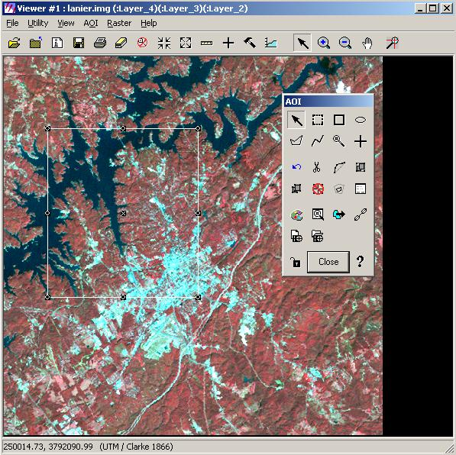
Create an AOI
1、
2、File—Save—AOI layers as…

Slide 10
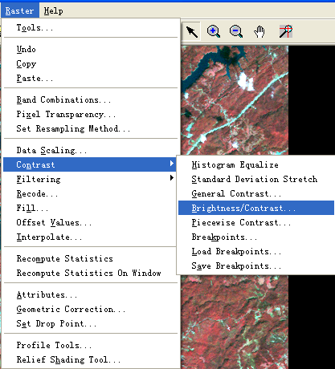
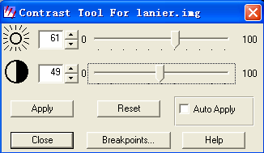
Adjust Image Contrast

Slide 11
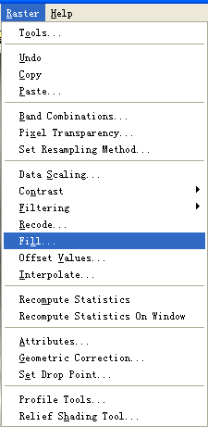
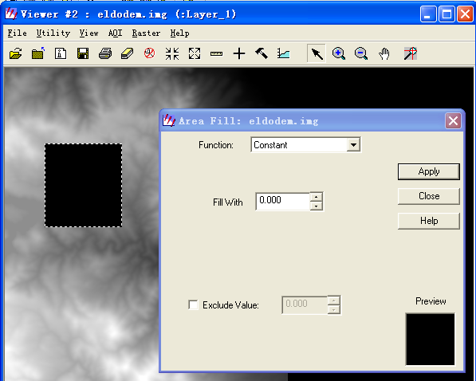
Fill AOI with a constant Value

Slide 12
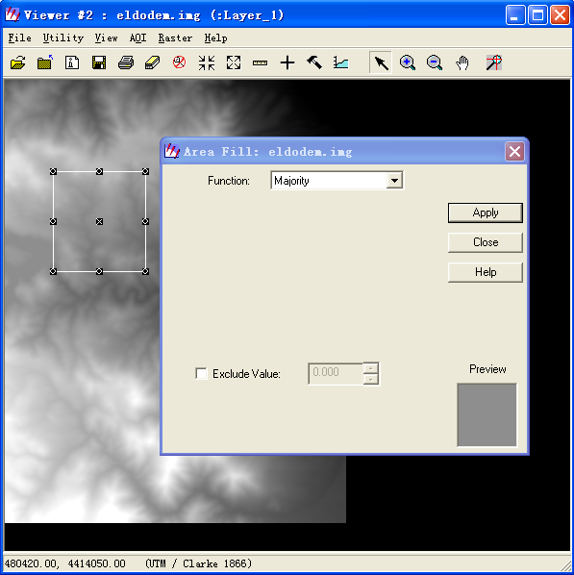
Fill –set global value

Slide 13
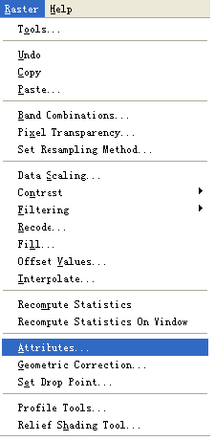
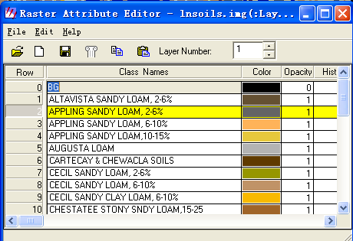
Raster Attribute Editor
示例：landcover.img

Slide 14
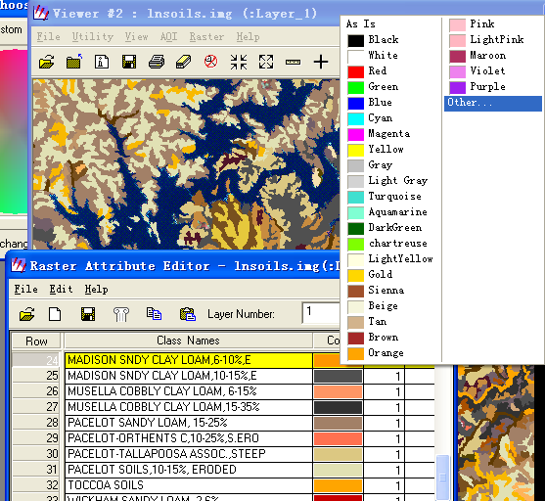
Make Layers Transparent
示例图像：Landcover.img Eosat TM.img

Slide 15
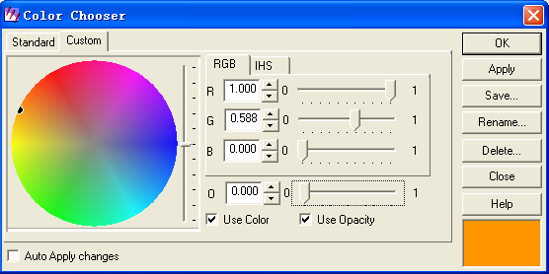
Make Layers Transparent

Slide 16
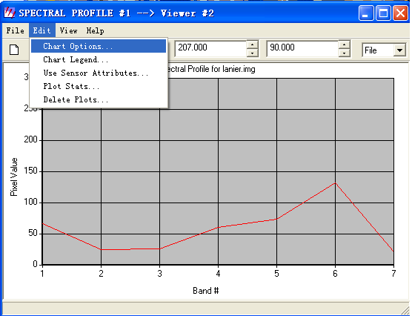
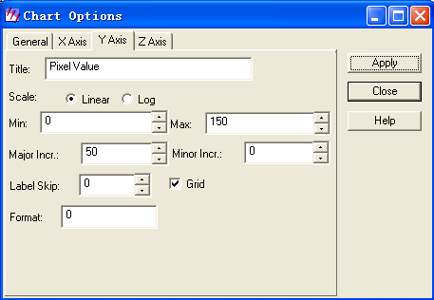
Profile Tools—Analyze Data

Slide 17
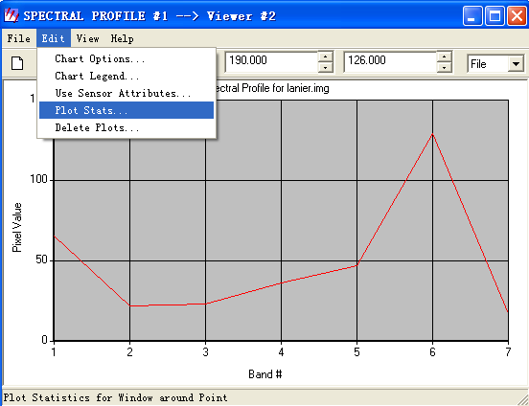
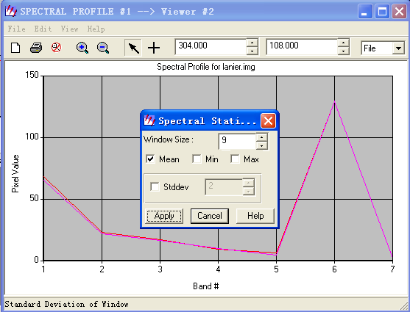
Profile Tools—Analyze Data

Slide 18
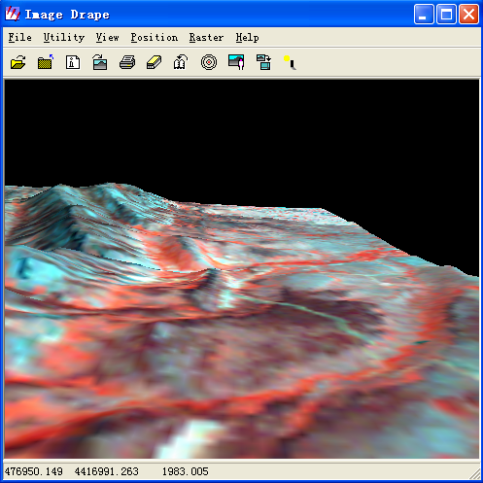
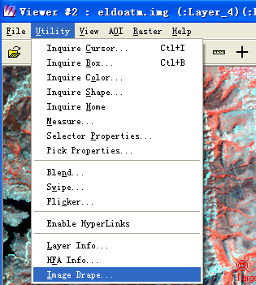
Image Drape
示例图像：eldodem.img eldoatm.img(top)

Slide 19
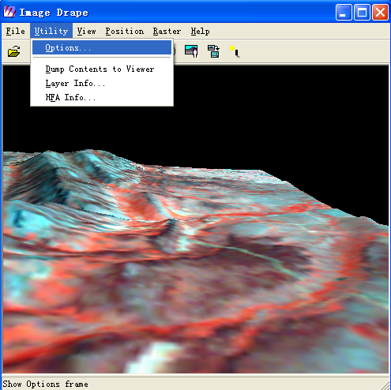
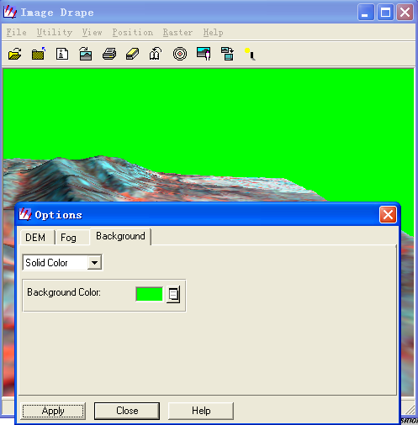
Image Drape—change options

Slide 20
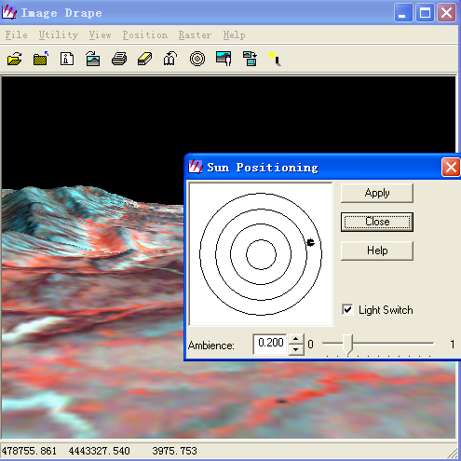
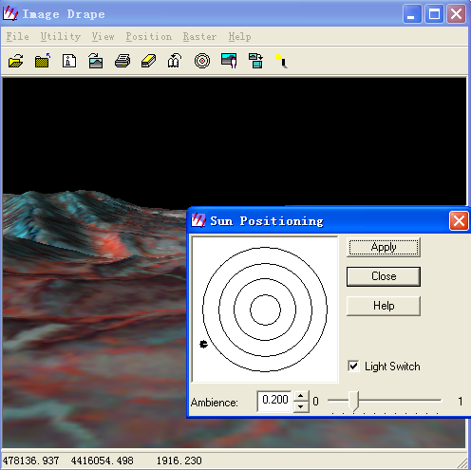
Image Drape—Change Sun Position

Slide 21
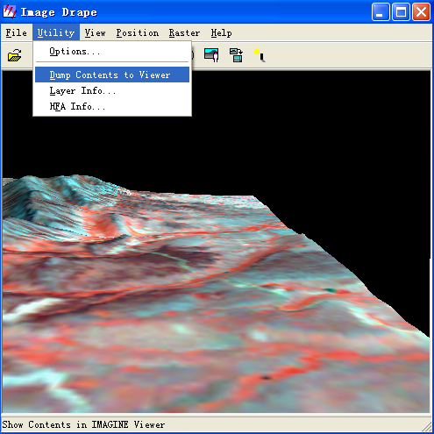
Image Drape—Dump Contents to viewer
1、关闭viewer1
2、在image drape窗口中点击如左图。
3、弹出viewer2窗口
4、在image drape窗口中选择view—link/unlink with viewer

Slide 22
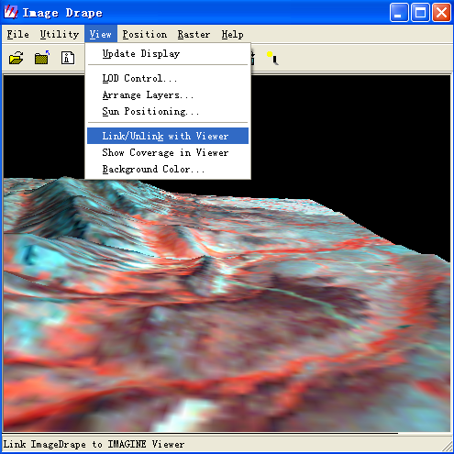
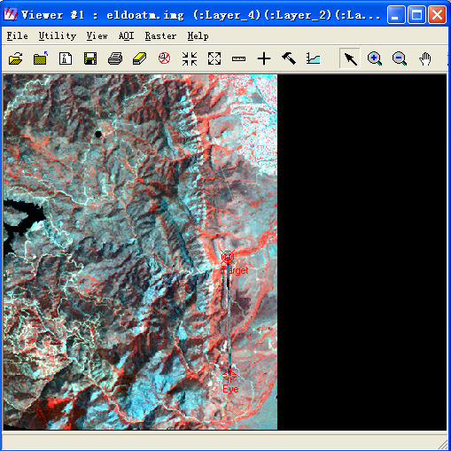
Image Drape—Dump Contents to viewer

Slide 23
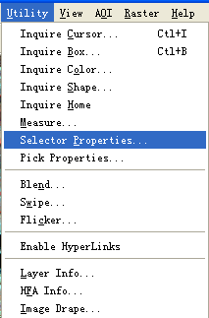
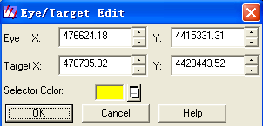
Image Drape—start eye/target

Slide 24

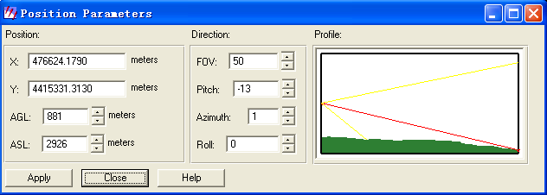
Maniputlate the Observer and Field of View

Slide 25

二、Catalog基本功能

Slide 26
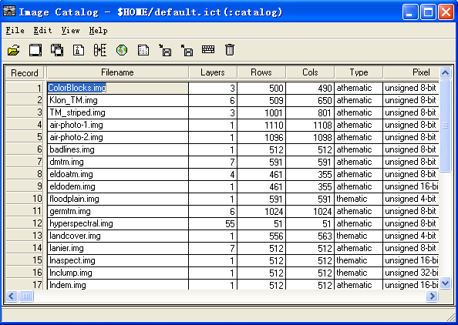
Catalog

Slide 27
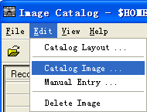

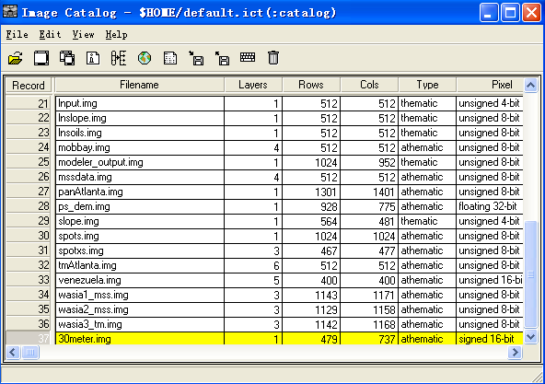
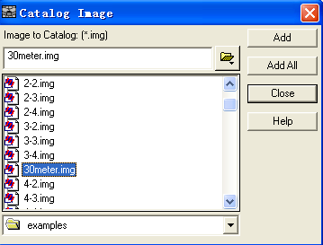
Add Information

Slide 28
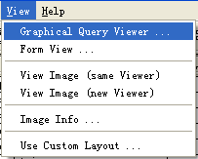
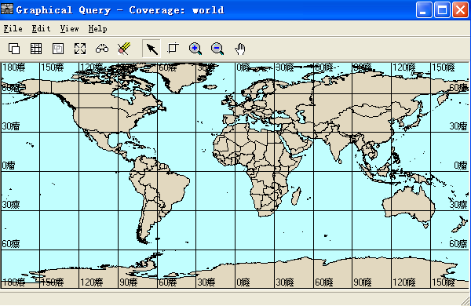
Perform Graphical Queries

Slide 29
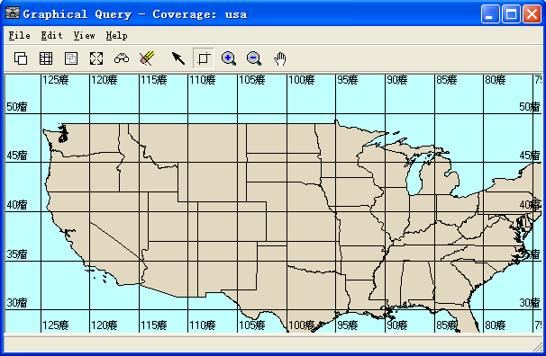
Perform Graphical Queries-select area

Slide 30
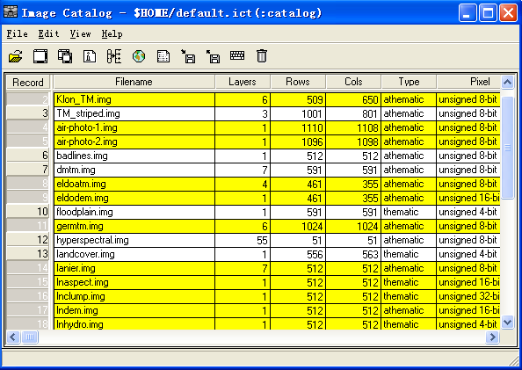
Perform Graphical Queries-Run Query

Slide 31
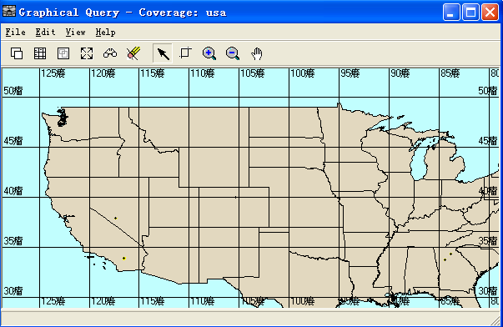
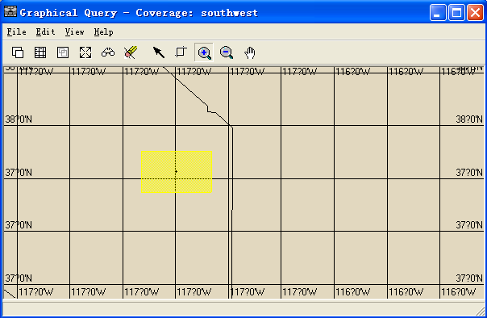
Perform Graphical Queries-Run Query

Slide 32
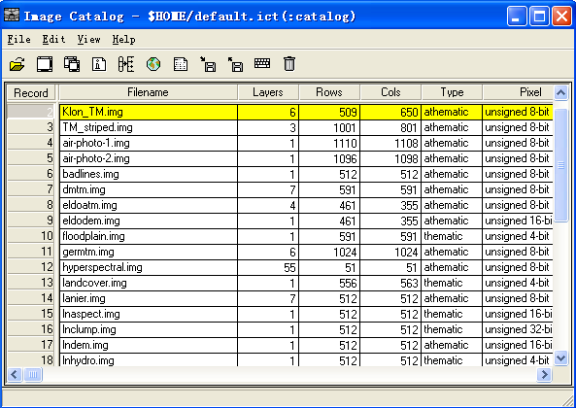
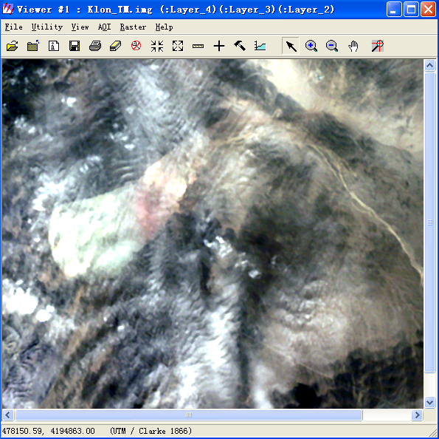
Perform Graphical Queries-Run Query

Slide 33

Perform Graphical Queries--Run Query
选择另一个数据点，新开一个viewer显示另外一幅图像

Slide 34
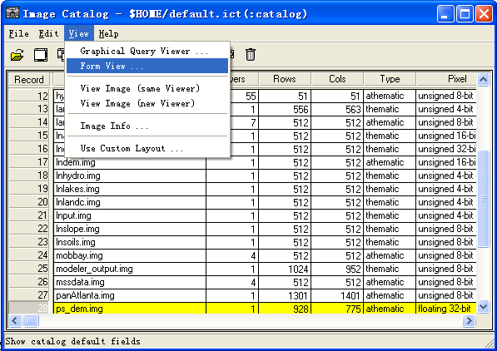

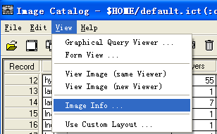
Perform Graphical Queries—View Information
1、
2、

Slide 35
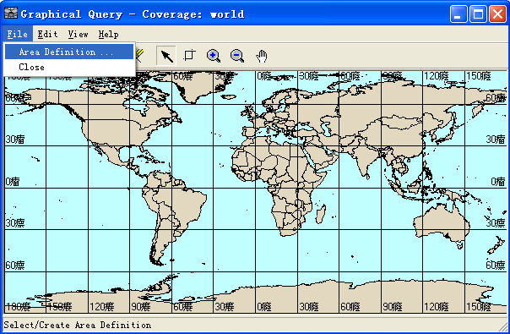
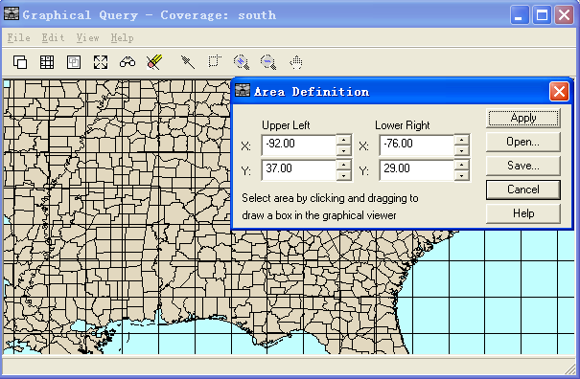
Perform Graphical Queries—Modify Views

